Slide 1
Crime and Mass Incarceration: Reform or a ‘new normal’?
Dr. Paul Leighton
Eastern Michigan University
Osher Lifelong Learning Institute lecture, January 21, 2016
Notes:
Paul Leighton, Crime and Mass Incarceration: Reform or a ‘new normal’? 2016. Lecture before the Osher Lifelong Learning Institute, University of Michigan. http://www.paulsjusticeblog.com/2016/05/crime_and_mass_incarceration_reform_newnormal.php

Slide 2
Sentencing reform so far…
The number of inmates in state and federal prisons has declined about 54,000 in the last five years.
Bureau of Justice Statistics, Prisoners in 2014, Table 1.
Notes:
Paul Leighton, Crime and Mass Incarceration: Reform or a ‘new normal’? 2016. Lecture before the Osher Lifelong Learning Institute, University of Michigan. http://www.paulsjusticeblog.com/2016/05/crime_and_mass_incarceration_reform_newnormal.php

Slide 3
Reform Scenarios, next 35 years…
Data from 1925 – 2014 from Bureau of Justice Statistics, Prisoners in 2014, Table 1.
Notes:
Paul Leighton, Crime and Mass Incarceration: Reform or a ‘new normal’? 2016. Lecture before the Osher Lifelong Learning Institute, University of Michigan. http://www.paulsjusticeblog.com/2016/05/crime_and_mass_incarceration_reform_newnormal.php

Slide 4
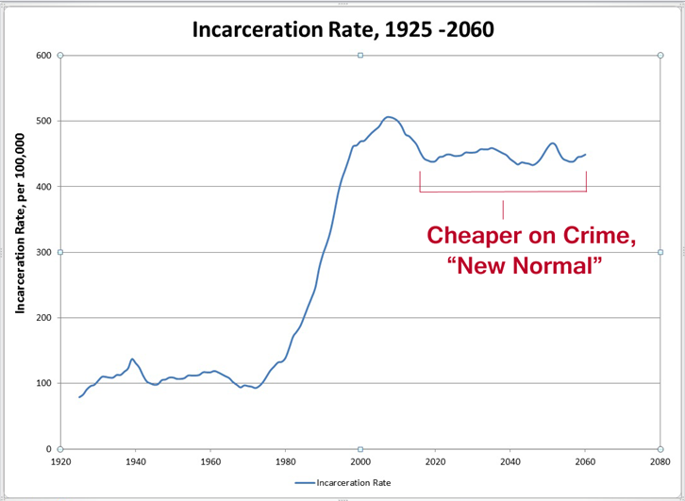
…or, fluctuations around this level
Data from 1925 – 2014 from Bureau of Justice Statistics, Prisoners in 2014, Table 1.
Notes:
Paul Leighton, Crime and Mass Incarceration: Reform or a ‘new normal’? 2016. Lecture before the Osher Lifelong Learning Institute, University of Michigan. http://www.paulsjusticeblog.com/2016/05/crime_and_mass_incarceration_reform_newnormal.php

Slide 5
Roadmap
The Problem of Mass Incarceration
Real Solutions
Notes:
Paul Leighton, Crime and Mass Incarceration: Reform or a ‘new normal’? 2016. Lecture before the Osher Lifelong Learning Institute, University of Michigan. http://www.paulsjusticeblog.com/2016/05/crime_and_mass_incarceration_reform_newnormal.php

Slide 6
10th edition, 2013
11th ed in progress
First published 1979
Put us out of business!!
Notes:
Paul Leighton, Crime and Mass Incarceration: Reform or a ‘new normal’? 2016. Lecture before the Osher Lifelong Learning Institute, University of Michigan. http://www.paulsjusticeblog.com/2016/05/crime_and_mass_incarceration_reform_newnormal.php

Slide 7
Incarceration Binge, Mass Incarceration & “A Plague of Prisons”
From 1980 to 2000, the U.S. built more prisons than it had in all the rest of its history
Notes:
Paul Leighton, Crime and Mass Incarceration: Reform or a ‘new normal’? 2016. Lecture before the Osher Lifelong Learning Institute, University of Michigan. http://www.paulsjusticeblog.com/2016/05/crime_and_mass_incarceration_reform_newnormal.php

Slide 8
Embarrassing global comparisons
Ranking | Title | Prison Population Rate
1 | Seychelles | 799
2 | United States of America | 698
3 | St. Kitts and Nevis | 607
4 | Turkmenistan | 583
5 | Virgin Islands (USA) | 542
6 | Cuba | 510
7 | El Salvador | 506
8 | Guam (USA) | 469
9 | Thailand | 467
10 | Belize | 449
11 | Russian Federation | 446
12 | Rwanda | 434
Source: World prison Brief (accessed 17 January 2016)
http://www.prisonstudies.org
Notes:
Paul Leighton, Crime and Mass Incarceration: Reform or a ‘new normal’? 2016. Lecture before the Osher Lifelong Learning Institute, University of Michigan. http://www.paulsjusticeblog.com/2016/05/crime_and_mass_incarceration_reform_newnormal.php

Slide 9
Little impact on crime
Violent crime rate and incarceration rate, 1960–2014
Violence is back to 1970 level when it was considered a big national problem – so big we needed a national commission to study the problem
Notes:
Paul Leighton, Crime and Mass Incarceration: Reform or a ‘new normal’? 2016. Lecture before the Osher Lifelong Learning Institute, University of Michigan. http://www.paulsjusticeblog.com/2016/05/crime_and_mass_incarceration_reform_newnormal.php

Slide 10
Prison can prevent crime…
Incapacitation – person in prison not committing crime in the community
BUT
People age out of crime, so longer sentences do not necessarily mean more crime prevention
Small group commits large amount of crime; increasing incarceration gets increasingly less criminal citizens
“Serious, repeat criminals”
Then
“serious and repeat criminals”
Notes:
Paul Leighton, Crime and Mass Incarceration: Reform or a ‘new normal’? 2016. Lecture before the Osher Lifelong Learning Institute, University of Michigan. http://www.paulsjusticeblog.com/2016/05/crime_and_mass_incarceration_reform_newnormal.php

Slide 11
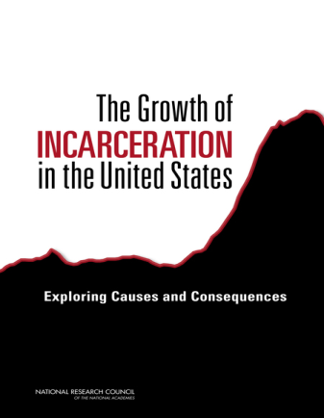
Prison can prevent crime…
Deterrence – “scare straight” sentenced individual or make them an example to others
BUT
A National Academy of Sciences panel examining incarceration noted that three earlier National Academy of Science panels found there was a lack of evidence to support the assumption that harsher punishments deter crime. “Despite those nearly unanimous findings, during the 1970s, 1980s, and 1990s the U.S. Congress and every state enacted laws calling for mandatory minimum sentences.” (p 90)
Notes:
Paul Leighton, Crime and Mass Incarceration: Reform or a ‘new normal’? 2016. Lecture before the Osher Lifelong Learning Institute, University of Michigan. http://www.paulsjusticeblog.com/2016/05/crime_and_mass_incarceration_reform_newnormal.php

Slide 12
Prison can cause crime…
Make person worse off: mental and physical health, reduced opportunities because of criminal record, stigma
“warehouse prison” not “rehabilitation center”
Children more likely to become delinquent
Reduces stable family formation
Creates social disorganization that erodes informal social control
Notes:
Paul Leighton, Crime and Mass Incarceration: Reform or a ‘new normal’? 2016. Lecture before the Osher Lifelong Learning Institute, University of Michigan. http://www.paulsjusticeblog.com/2016/05/crime_and_mass_incarceration_reform_newnormal.php

Slide 13
“The crucial issue is not whether some negative effects [from incarceration] occur in communities; they most certainly do. Rather it is whether those effects overwhelm the crime reducing mechanisms of prison, deterrence and incarceration, which also most certainly occur.”
Useem and Piehl. 2008. Prison State: The Challenge of Mass Incarceration. Cambridge University Press. p, 52.
The relative weight of the positive and negative effects depends on the number of people incarcerated:
Increasing the number of people incarcerated is most effective when relatively few people are in prison
Further increases will have declining effectiveness for crime control
At some point, further increases can cause more crime that it prevents.
Notes:
Paul Leighton, Crime and Mass Incarceration: Reform or a ‘new normal’? 2016. Lecture before the Osher Lifelong Learning Institute, University of Michigan. http://www.paulsjusticeblog.com/2016/05/crime_and_mass_incarceration_reform_newnormal.php

Slide 14
Increasing Incarceration, Decreasing Effectiveness
Brennan Center, What Caused the Crime Decline (2015)
Notes:
Paul Leighton, Crime and Mass Incarceration: Reform or a ‘new normal’? 2016. Lecture before the Osher Lifelong Learning Institute, University of Michigan. http://www.paulsjusticeblog.com/2016/05/crime_and_mass_incarceration_reform_newnormal.php

Slide 15
Increasing Incarceration, Decreasing Effectiveness
Brennan Center, What Caused the Crime Decline (2015)
Notes:
Paul Leighton, Crime and Mass Incarceration: Reform or a ‘new normal’? 2016. Lecture before the Osher Lifelong Learning Institute, University of Michigan. http://www.paulsjusticeblog.com/2016/05/crime_and_mass_incarceration_reform_newnormal.php

Slide 16
Generous best estimate
Brennan Center, What Caused the Crime Decline (2015)
Notes:
Paul Leighton, Crime and Mass Incarceration: Reform or a ‘new normal’? 2016. Lecture before the Osher Lifelong Learning Institute, University of Michigan. http://www.paulsjusticeblog.com/2016/05/crime_and_mass_incarceration_reform_newnormal.php

Slide 17
Sacrificing Education to Have More Crime?
American Academy of Arts and Sciences, Public Research Universities: Changes in Public Funding (2015)
Notes:
Paul Leighton, Crime and Mass Incarceration: Reform or a ‘new normal’? 2016. Lecture before the Osher Lifelong Learning Institute, University of Michigan. http://www.paulsjusticeblog.com/2016/05/crime_and_mass_incarceration_reform_newnormal.php

Slide 18
Sentencing Reform
The repeal or substantial narrowing of all three-strikes, mandatory minimum, life-without-possibility-of-parole, and truth in sentencing laws…
... combined with the expansion of parole
would eventually cut the incarceration rate in half.
The U.S. incarceration rate would be still be at “a level three to four times those of other developed Western countries, [which] can hardly be considered overly ambitious.”
-Tonry, Remodeling American Sentencing, p 527.
Notes:
Paul Leighton, Crime and Mass Incarceration: Reform or a ‘new normal’? 2016. Lecture before the Osher Lifelong Learning Institute, University of Michigan. http://www.paulsjusticeblog.com/2016/05/crime_and_mass_incarceration_reform_newnormal.php

Slide 19
Solutions for crime and violence
Crime is individual choice
Made within the context of family, neighborhood and community, which are
Shaped by economic, social and political policies
Social, Political, Legal & Economic Institutions
National Level
State Level
Local Level
Community
Family, friends, neighborhood
Individual
Notes:
Paul Leighton, Crime and Mass Incarceration: Reform or a ‘new normal’? 2016. Lecture before the Osher Lifelong Learning Institute, University of Michigan. http://www.paulsjusticeblog.com/2016/05/crime_and_mass_incarceration_reform_newnormal.php

Slide 20
Solutions for crime and violence
“four priorities seem especially critical: preventing child abuse and neglect, enhancing children’s intellectual and social development, providing support and guidance to vulnerable adolescents, and working extensively with juvenile offenders.”
-Currie, Crime and Punishment in America, p. 81
“the best of [the programs] work, and they work remarkably well given how limited and underfunded they usually are.” p 98
Notes:
Paul Leighton, Crime and Mass Incarceration: Reform or a ‘new normal’? 2016. Lecture before the Osher Lifelong Learning Institute, University of Michigan. http://www.paulsjusticeblog.com/2016/05/crime_and_mass_incarceration_reform_newnormal.php

Slide 21
Solutions for crime and violence
High Return on Investment (ROI) from crime prevention programs
No program [save tax $ now]
But spend money later on
incarceration
Crime prevention [spend tax $ now]
Individual contributes to economy
Job = payroll and sales taxes
Public assistance
Unemployment
Notes:
Paul Leighton, Crime and Mass Incarceration: Reform or a ‘new normal’? 2016. Lecture before the Osher Lifelong Learning Institute, University of Michigan. http://www.paulsjusticeblog.com/2016/05/crime_and_mass_incarceration_reform_newnormal.php

Slide 22
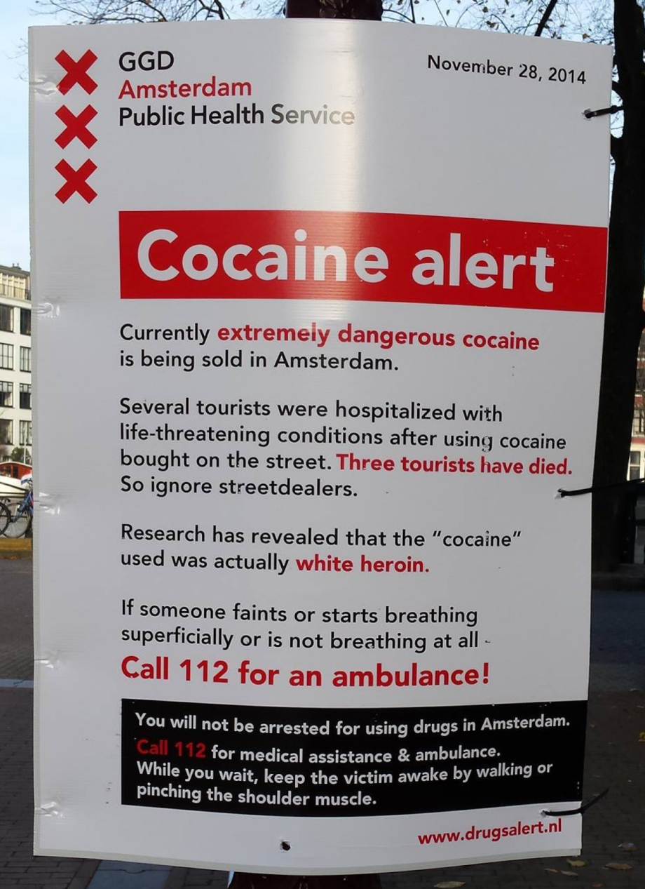
De-escalate drug war
Treatment for drug addiction is “prohibitively expensive, overcrowded, underfunded and subject to byzantine government rules.” Obama administration drug czar Michael Botticelli “estimates that up to 80 percent of heroin addicts are never treated.”
Ingraham, ‘You will not be arrested for using drugs': What a sane drug policy looks like. Washington Post, 2 Dec 2014
Marc Fisher and Katie Zezima. 2015. This is where heroin almost killed her. Washington Post, 3 Oct 2015
Notes:
Paul Leighton, Crime and Mass Incarceration: Reform or a ‘new normal’? 2016. Lecture before the Osher Lifelong Learning Institute, University of Michigan. http://www.paulsjusticeblog.com/2016/05/crime_and_mass_incarceration_reform_newnormal.php

Slide 23
De-escalate drug war
In 2001 Portugal eliminated criminal penalties for all drugs in amounts for personal use.
Possession still triggers a hearing before the Commission for the Dissuasion of Drug Addiction, a three-person tribunal that discourages drug use and encourages addicts to get treatment.
An evaluation found reductions in problematic drug use and concludes that Portugal’s experience
demonstrates that—contrary to some predictions—decriminalization does not inevitably lead to rises in drug use. It can reduce the burden upon the criminal justice system. It can further contribute to social and health benefits. Moreover, such effects can be observed when decriminalizing all illicit drugs. This is important, as decriminalization is commonly restricted to cannabis alone.
Hughes and Steven. 2010. What Can We Learn From The Portuguese Decriminalization Of Illicit Drugs? British Journal of Criminology, 50(6), p. 1016.
Notes:
Paul Leighton, Crime and Mass Incarceration: Reform or a ‘new normal’? 2016. Lecture before the Osher Lifelong Learning Institute, University of Michigan. http://www.paulsjusticeblog.com/2016/05/crime_and_mass_incarceration_reform_newnormal.php

Slide 24
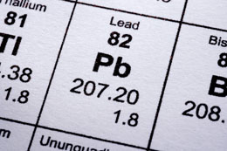
Remove lead
Neurotoxin – poisons brain cells and connections
No safe level, accumulates [childhood exposure esp problematic]
Lower IQ, attention deficit, impulsivity, homicide rates, delinquency, and violent crime (Barrett, Lead and Crime. Oxford Bibliographies in Criminology. 2013)
Lead abatement leads to permanent crime reduction of “at least 10 percent. All the other cognitive and health benefits would be gravy. It’s hard to imagine any other crime-control expenditure with anything like that much bang for the buck.”
Kleiman, Smart on Crime. Democracy: A Journal of Ideas. Spring 2013.
Notes:
Paul Leighton, Crime and Mass Incarceration: Reform or a ‘new normal’? 2016. Lecture before the Osher Lifelong Learning Institute, University of Michigan. http://www.paulsjusticeblog.com/2016/05/crime_and_mass_incarceration_reform_newnormal.php

Slide 25
Prison Should Rehabilitate
Notes:
Paul Leighton, Crime and Mass Incarceration: Reform or a ‘new normal’? 2016. Lecture before the Osher Lifelong Learning Institute, University of Michigan. http://www.paulsjusticeblog.com/2016/05/crime_and_mass_incarceration_reform_newnormal.php

Slide 26
Reduce Inequality
Not “just” poverty – inequality, relative deprivation and concentrated disadvantage
“Inequality worsens both crimes of poverty motivated by need and crimes of wealth motivated by greed” Braithwaite, Poverty Power and White Collar Crime, in Schlegel and Weisburd, White-Collar Crime Reconsidered. Northeastern University Press (1992).
Notes:
Paul Leighton, Crime and Mass Incarceration: Reform or a ‘new normal’? 2016. Lecture before the Osher Lifelong Learning Institute, University of Michigan. http://www.paulsjusticeblog.com/2016/05/crime_and_mass_incarceration_reform_newnormal.php

Slide 27
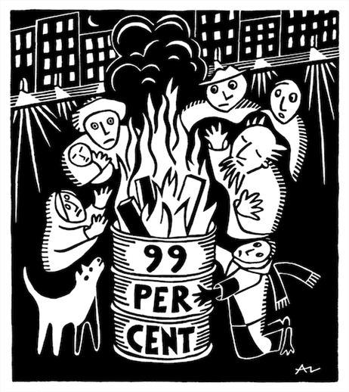
Inequality & crimes of the poor
“Need”: absolute, perceive others to have, what whites have, expectations based on “advertising and dramatization of bourgeois lifestyles” (Braithwaite 1992 p 83)
Fewer legitimate means to success, so more people try illegitimate means
http://occuprint.org
Notes:
Paul Leighton, Crime and Mass Incarceration: Reform or a ‘new normal’? 2016. Lecture before the Osher Lifelong Learning Institute, University of Michigan. http://www.paulsjusticeblog.com/2016/05/crime_and_mass_incarceration_reform_newnormal.php

Slide 28
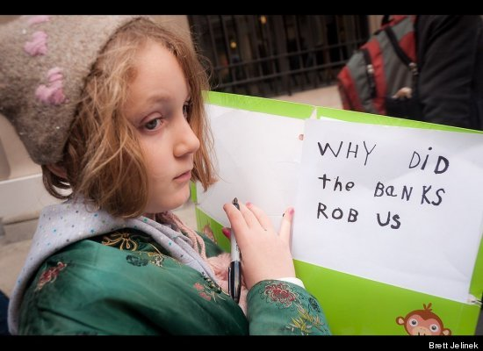
Inequality & crimes of the rich
“increasing concentrations of wealth [enables] the constitution of new forms of illegitimate opportunity” (p 85)
Novel illegitimate strategies that “excel because they cannot be contemplated by those who are not wealthy” (p 88)
“people in positions of power have opportunity to commit crimes that involve the abuse of power, and the more power they have, the more abusive those crimes can be” (p 89)
“undermines respect for the dominion of others” (p 80)
“power corrupts and unaccountable power corrupts with impunity” (p 89)
All quotes from Braithwaite 1992
Notes:
Paul Leighton, Crime and Mass Incarceration: Reform or a ‘new normal’? 2016. Lecture before the Osher Lifelong Learning Institute, University of Michigan. http://www.paulsjusticeblog.com/2016/05/crime_and_mass_incarceration_reform_newnormal.php

Slide 29
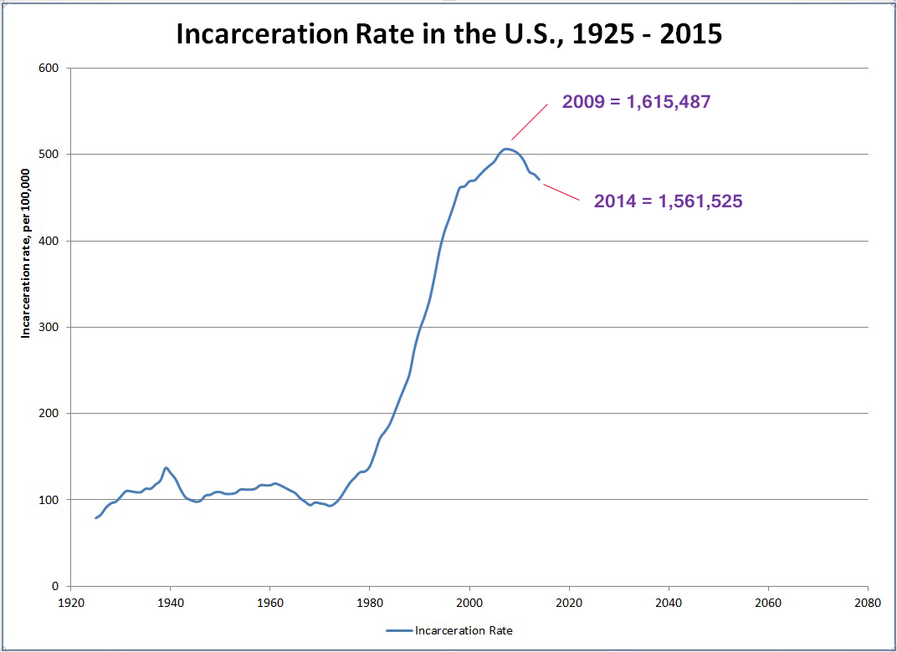
Conclusions: Sentencing reform
Sentencing reform has nibbled around the edges and must get more substantial
Not clear if we are going to be “smart on crime” or “cheap on crime”
“if an economic downturn produces changes in our correctional policies, do they last when the market recovers?”
-Aviram, Cheap on Crime (2015), p 14
Notes:
Paul Leighton, Crime and Mass Incarceration: Reform or a ‘new normal’? 2016. Lecture before the Osher Lifelong Learning Institute, University of Michigan. http://www.paulsjusticeblog.com/2016/05/crime_and_mass_incarceration_reform_newnormal.php

Slide 30
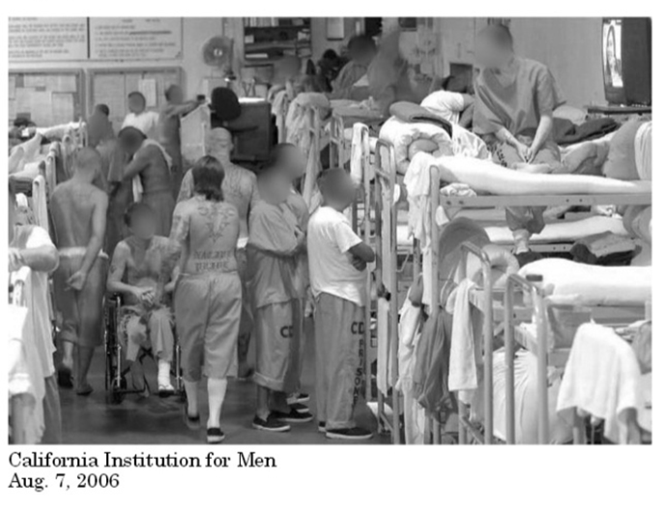
Conclusions: post-warehouse prison
Fewer warehouse prisons
Reform/improve/transform existing warehouse prisons
and
Create experimental space for next-generation rehabilitation center
If you knew your neighbor was recently released from prison, what kind of prison would you like it to be?
Notes:
Paul Leighton, Crime and Mass Incarceration: Reform or a ‘new normal’? 2016. Lecture before the Osher Lifelong Learning Institute, University of Michigan. http://www.paulsjusticeblog.com/2016/05/crime_and_mass_incarceration_reform_newnormal.php

Slide 31
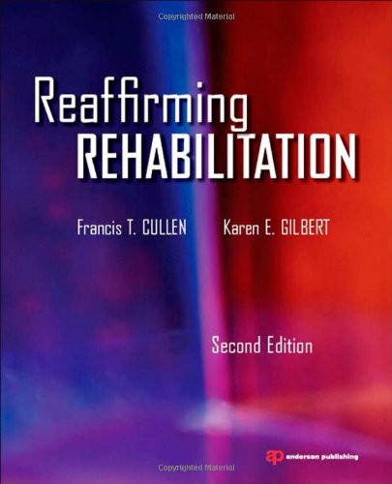
Conclusions: Reaffirm rehabilitation
“the rehabilitative ideal draws its power from its nobility and its rationality — from the promise that compassionate science, rather than vengeful punishment, is the road to reducing crime.
Rehabilitation allows us to be a better and safer people”
-Francis Cullen
quoted in Leighton, Paul. 2014. “A model prison for the next 50 years”: The high-tech, public private Shimane Asahi Rehabilitation Center. Justice Policy Journal, 11(1),
Notes:
Paul Leighton, Crime and Mass Incarceration: Reform or a ‘new normal’? 2016. Lecture before the Osher Lifelong Learning Institute, University of Michigan. http://www.paulsjusticeblog.com/2016/05/crime_and_mass_incarceration_reform_newnormal.php

Slide 32
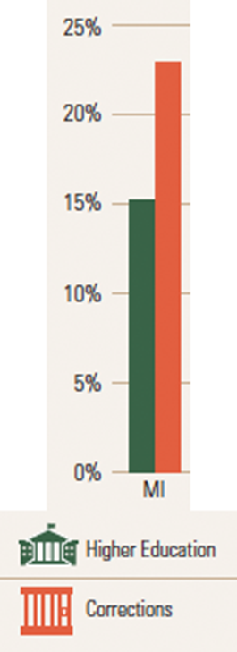
Conclusions: Crime Prevention
Police and prisons necessary, but ineffective at crime prevention and reducing problems related to drug use
National Academy of Sciences, Fairness and Effectiveness in Policing: The Evidence
“a century of criminological research has documented the powerful impact of a long list of social and economic factors on crime… and they are mainly beyond the reach of the police” (2004, p 247)
Not smart or sustainable
Notes:
Paul Leighton, Crime and Mass Incarceration: Reform or a ‘new normal’? 2016. Lecture before the Osher Lifelong Learning Institute, University of Michigan. http://www.paulsjusticeblog.com/2016/05/crime_and_mass_incarceration_reform_newnormal.php

Slide 33
Conclusions: Crime Prevention
Invest in crime prevention
Hundreds of evidence-based programs for individuals, families – need the political will to spend on them
Changes to produce more social and economic justice – need the political to make changes
“We are called upon to raise certain basic questions about the whole society”
MLK, as quoted in Alexander, The New Jim Crow (2012), p 259.
Notes:
Paul Leighton, Crime and Mass Incarceration: Reform or a ‘new normal’? 2016. Lecture before the Osher Lifelong Learning Institute, University of Michigan. http://www.paulsjusticeblog.com/2016/05/crime_and_mass_incarceration_reform_newnormal.php

Slide 34
Please,
put us
out of business!!
Notes:
Paul Leighton, Crime and Mass Incarceration: Reform or a ‘new normal’? 2016. Lecture before the Osher Lifelong Learning Institute, University of Michigan. http://www.paulsjusticeblog.com/2016/05/crime_and_mass_incarceration_reform_newnormal.php

Slide 35
Dr. Paul Leighton is a professor in the Department of Sociology, Anthropology & Criminology at Eastern Michigan University.
More information about him is available on his website,
http://paulsjusticepage.com/paul/pauls-cv.htm
See also:
The Problems With Private Prisons,
http://www.paulsjusticeblog.com/2013/04/the_problems_with_private_prisons.php
Prison Privatization in the U.S. and Japan (2014 OLLI lecture)
http://www.paulsjusticeblog.com/2014/06/we_need_a_postwarehouse_prison.php
Notes:
Leighton, Paul. 2013. Criminology Needs More Class; Inequality, Corporate Persons and an Impoverished Discipline. Available, http://www.paulsjusticeblog.com/2012/11/criminology_needs_more_class.php.

