Slide 1
Manifestations of Poverty: The Rich Get Richer and the Poor Get Prison
Paul Leighton
Star Lecture
EMU Honors College
Sept 2013
http://occuprint.org/
Notes:
Leighton, Paul. 2013. Manifestations of Poverty: The Rich Get Richer and the Poor Get Prison. Star Lecture, EMU Honors College. Sept 2013. http://paulsjusticepage.com

Slide 2
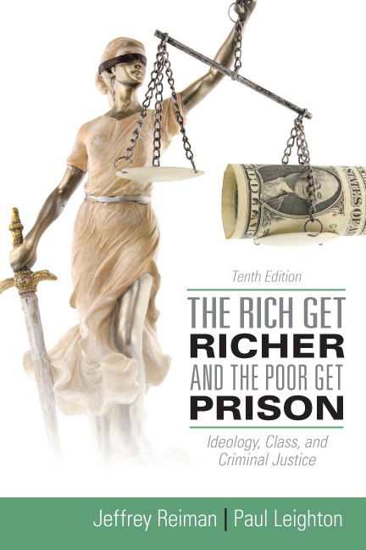
The creators of any graphics used in this presentation who want attribution or removal should contact me through my website, http://paulsjusticepage.com.
Notes:
Leighton, Paul. 2013. Manifestations of Poverty: The Rich Get Richer and the Poor Get Prison. Star Lecture, EMU Honors College. Sept 2013. http://paulsjusticepage.com

Slide 3
Roadmap
Inequality (There is more than you realize)
Income
Wealth
Corporate ‘persons’ and inequality
Criminology
Inequality and crime
Inequality and the criminal justice system
Conclusions
http://occuprint.org/
Notes:
Leighton, Paul. 2013. Manifestations of Poverty: The Rich Get Richer and the Poor Get Prison. Star Lecture, EMU Honors College. Sept 2013. http://paulsjusticepage.com

Slide 4
There’s More Inequality Than You Think
Ideology
“when ideas, however unintentionally, distort reality in a way that justifies the prevailing distribution of power and wealth, hides society’s injustices, and thus secures uncritical allegiance to the existing social order”
Reiman and Leighton, The Rich Get Richer & The Poor Get Prison, 10th ed. (2013:183)
Notes:
Leighton, Paul. 2013. Manifestations of Poverty: The Rich Get Richer and the Poor Get Prison. Star Lecture, EMU Honors College. Sept 2013. http://paulsjusticepage.com

Slide 5
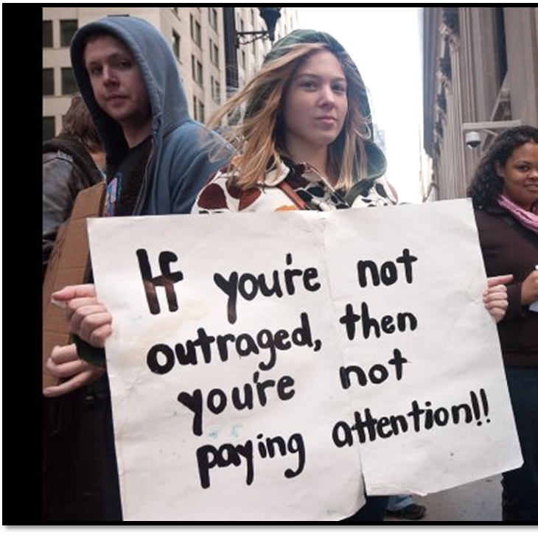
Income Overview
INCOME = SALARY
For richer, it includes interest and
dividends (not capital gains in
Census data)
Median household income
was $49,445 in 2010
Official poverty rate = 15.1% (22% for children)
46.2 million people = largest number in the 52 years for which poverty estimates have been published
DeNavas-Walt, Carmen, Bernadette D. Proctor, and Jessica C. Smith, U.S. Census Bureau, Current Population Reports, P60-239, Income, Poverty, and Health Insurance Coverage in the United States: 2010, U.S. Government Printing Office, Washington, DC,2011. http://www.census.gov/hhes/www/income/income.html.
Notes:
Leighton, Paul. 2013. Manifestations of Poverty: The Rich Get Richer and the Poor Get Prison. Star Lecture, EMU Honors College. Sept 2013. http://paulsjusticepage.com

Slide 6
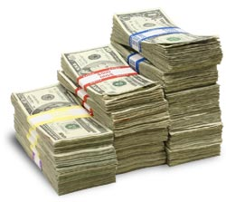
Income Privilege
Both high and low income can spend much of what they make, so you can still be “rich” and have class privilege if you have $0 at the end of the month.
Consider:
I can buy things for my comfort
I do not fear being hungry or homeless
I have the time and money to take care of my body
I do not worry about my access to medical care
I can advocate for my class without being seen as looking for a handout.
Whenever I’ve moved out of my home it has been voluntary, and I had another home to move into.
I hunted for sport, not because of food insecurity
Pease, Bob. 2010. Undoing Privilege (Zed Books); 30+ Examples of Middle to Upper Class Privilege, http://itspronouncedmetrosexual.com/2012/10/list-of-upperclass-privilege/.
Notes:
Leighton, Paul. 2013. Manifestations of Poverty: The Rich Get Richer and the Poor Get Prison. Star Lecture, EMU Honors College. Sept 2013. http://paulsjusticepage.com

Slide 7
Income Distribution, 2010
Households | Share of Aggregate Income | Upper Limit (You are in this group if you make less than…)
Lowest Fifth | 3.3% | $20,000
Second Fifth | 8.5% | $38,043
Third Fifth | 14.6% | $61,735
Fourth Fifth | 23.4% | $100,065
Highest Fifth | 50.2% | ????
Top 5% | 21.3% | Lower limit = $180,810
U.S. Census Bureau, Current Population Survey, Annual Social and Economic Supplements, Tables H-1 and H-2
http://www.census.gov/hhes/www/income/data/historical/household/
Notes:
Leighton, Paul. 2013. Manifestations of Poverty: The Rich Get Richer and the Poor Get Prison. Star Lecture, EMU Honors College. Sept 2013. http://paulsjusticepage.com

Slide 8
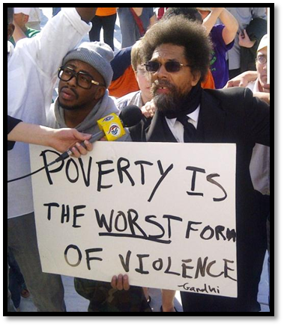
Income Distribution, 2010
Households | Upper Limit (You are in this group if you make less than…)
Lowest Fifth | $20,000
Second Fifth | $38,043
Third Fifth | $61,735
Fourth Fifth | $100,065
Highest Fifth
Top 5% | Lower limit = $180,810
John Paulson $4.9 billion
Ray Dalio $3.1 billion
(Hedge fund managers)
U.S. Census Bureau, Current Population Survey, Annual Social and Economic Supplements, Tables H-1 and H-2
http://www.census.gov/hhes/www/income/data/historical/household/
2010 Highest Paid hedge-Fund Managers (2011) http://www.therichest.org/business/highest-paid-hedge-fund-managers-2010/
Notes:
Leighton, Paul. 2013. Manifestations of Poverty: The Rich Get Richer and the Poor Get Prison. Star Lecture, EMU Honors College. Sept 2013. http://paulsjusticepage.com

Slide 9
Income Inequality Over Time
Repeated surveys “since 1987 have found that 60 percent or more of Americans agree or strongly agree with the statement that ‘differences in income in America are too large.’”
CNN. 2011. How the middle class became the underclass.
For data used to build graph, see Emmanual Saez’s webpage, http://elsa.berkeley.edu/~saez/.
Whoriskey, Peter. 2011. With executive pay, rich pull away from rest of America. Washington Post, June 18.
Notes:
Leighton, Paul. 2013. Manifestations of Poverty: The Rich Get Richer and the Poor Get Prison. Star Lecture, EMU Honors College. Sept 2013. http://paulsjusticepage.com

Slide 10
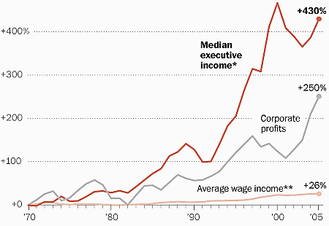
Income Inequality: Executive Pay
* Based on the salary, bonuses and stock options of the three highest-paid officers in the largest 50 firms.
** Calculated from Bureau of Economic Analysis data.
NOTE: All figures have been adjusted for inflation.
It’s NOT ‘pay for performance’ when executive pay rises faster than corporate profits.
Whoriskey, Peter. 2011. With executive pay, rich pull away from rest of America. Washington Post, June 18. http://www.washingtonpost.com/business/economy/with-executive-pay-rich-pull-away-from-rest-of-america/2011/06/13/AGKG9jaH_story.html.
Notes:
Leighton, Paul. 2013. Manifestations of Poverty: The Rich Get Richer and the Poor Get Prison. Star Lecture, EMU Honors College. Sept 2013. http://paulsjusticepage.com

Slide 11
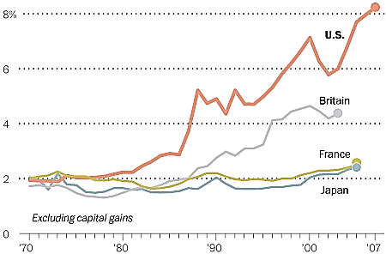
Income Inequality: International Comparisons
Share of income earned by top 0.1%
Washington Post. No date. (NOT) Spreading the Wealth
http://www.washingtonpost.com/wp-srv/special/business/income-inequality/.
Notes:
Leighton, Paul. 2013. Manifestations of Poverty: The Rich Get Richer and the Poor Get Prison. Star Lecture, EMU Honors College. Sept 2013. http://paulsjusticepage.com

Slide 12
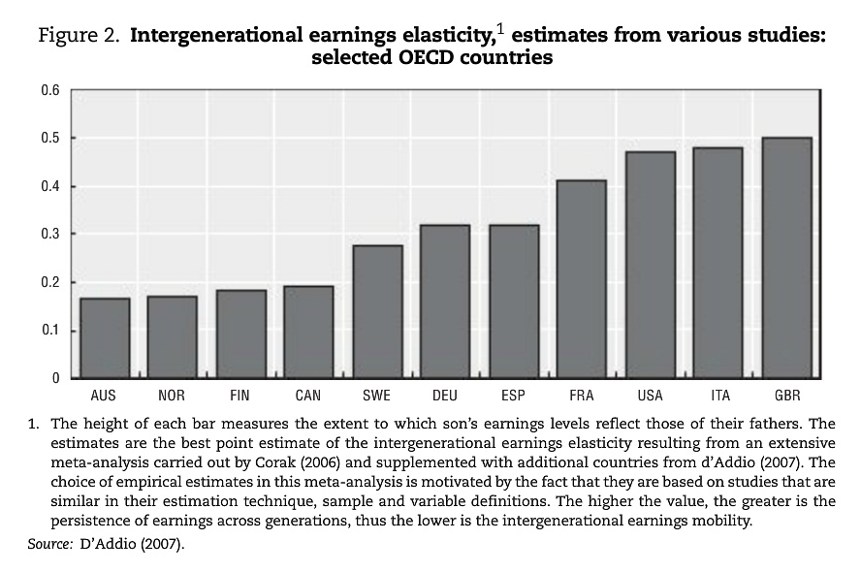
Intergenerational Mobility
Causa, Orsetta and Asa Johansson. 2010. Intergenerational Social
Mobility in OECD Countries.
OECD Journal: Economic
Studies, Volume 2010.
p 3 (quote) and p 9 (chart)
“Low mobility across generations, as measured by a close link between parents’ and children’s earnings, is particularly pronounced in the United Kingdom, Italy, the United States and France, while mobility is higher in the Nordic countries, Australia and Canada.”
Notes:
Leighton, Paul. 2013. Manifestations of Poverty: The Rich Get Richer and the Poor Get Prison. Star Lecture, EMU Honors College. Sept 2013. http://paulsjusticepage.com

Slide 13
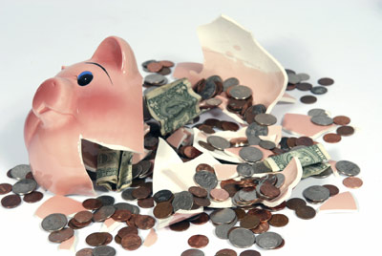
Wealth Overview
Wealth (net worth) = assets – liabilities
Median net worth, 2010 = $77,300
[mean = $498,800]
White, non-Hispanic = $130,600
Nonwhite or Hispanic = $20,400
Black = $15,500
Wealth is about
SECURITY and POWER
Jesse Bricker, Arthur B. Kennickell, Kevin B. Moore, and John Sabelhaus. 2012. Changes in U.S. Family Finances from 2007 to 2010: Evidence from the Survey of Consumer Finances. Federal Reserve Bulletin, vol. 98, no 2. P 17 and 21. http://www.federalreserve.gov/pubs/bulletin/2012/pdf/scf12.pdf.
Notes:
Leighton, Paul. 2013. Manifestations of Poverty: The Rich Get Richer and the Poor Get Prison. Star Lecture, EMU Honors College. Sept 2013. http://paulsjusticepage.com

Slide 14
If you were going to be randomly placed in a society, how would you distribute wealth?
Each block represents 20% of the population
How much wealth does each block get?
What % of the wealth do the poorest 20% get? The richest 20%?
Poorest 20% |  | Middle 20% |  | Richest 20%
Norton, Michael and Dan Ariely. 2011. Building a Better America. Perspectives on Psychological Science, 6(1): 9-12
Notes:
Leighton, Paul. 2013. Manifestations of Poverty: The Rich Get Richer and the Poor Get Prison. Star Lecture, EMU Honors College. Sept 2013. http://paulsjusticepage.com

Slide 15
If you were going to be randomly placed in a society, which one would you choose?
Norton, Michael and Dan Ariely. 2011. Building a Better America. Perspectives on Psychological Science, 6(1): 9-12
Notes:
Leighton, Paul. 2013. Manifestations of Poverty: The Rich Get Richer and the Poor Get Prison. Star Lecture, EMU Honors College. Sept 2013. http://paulsjusticepage.com

Slide 16
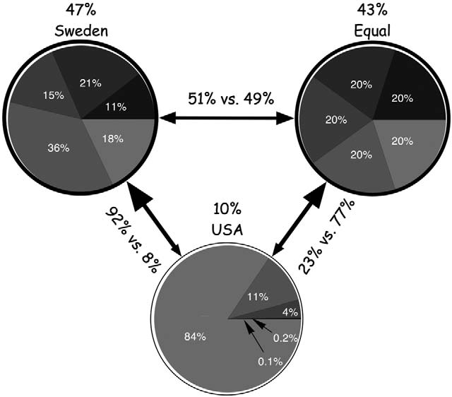
If you were going to be randomly placed in a society, which would you choose?
N = 5,000
Norton, Michael and Dan Ariely. 2011. Building a Better America. Perspectives on Psychological Science, 6(1): 9-12
Notes:
Leighton, Paul. 2013. Manifestations of Poverty: The Rich Get Richer and the Poor Get Prison. Star Lecture, EMU Honors College. Sept 2013. http://paulsjusticepage.com

Slide 17
Actual, estimated and ideal distributions of wealth
Top 20% actually control 84% of wealth; people believe they control 59%; ideally, top 20% should control 32%
Bottom 60% actually own 5% of wealth; people believe they control about 20%; ideally, the bottom 60% should control 45% of wealth.
Norton, Michael and Dan Ariely. 2011. Building a Better America. Perspectives on Psychological Science, 6(1): 9-12
Notes:
Leighton, Paul. 2013. Manifestations of Poverty: The Rich Get Richer and the Poor Get Prison. Star Lecture, EMU Honors College. Sept 2013. http://paulsjusticepage.com

Slide 18
Wealth Distribution, 2010
Households | Share of Aggregate Wealth (2010) | Notes (from 2007 data)
Bottom 50% | 1.1% | At 10th Percentile, wealth = $0
50 – 90th percentile | 24.3% | Upper limit of 75th percentile = $372,000 90th percentile = $908,200
90 – 99th percentile | 40%
99 – 100th percentile | 34.5% | Own 52% of stock and 63% of equity in private business
Top percentile does not include Forbes 400. 2010 total wealth = $1.27 trillion (min = $950 million, max = $50 billion)
Kennickell, Arthur. 2011. Tossed and Turned: Wealth Dynamics of U.S. Households 2007-2009.
http://www.federalreserve.gov/pubs/feds/2011/201151/revision/201151pap.pdf. Page 12.
Kennickell, Arthur. 2009. Ponds and Streams: Wealth and Income in the U.S., 1989 to 2007.
http://www.federalreserve.gov/pubs/feds/2009/200913/200913pap.pdf. Table 2, 4, A1, A3a
Notes:
Leighton, Paul. 2013. Manifestations of Poverty: The Rich Get Richer and the Poor Get Prison. Star Lecture, EMU Honors College. Sept 2013. http://paulsjusticepage.com

Slide 19
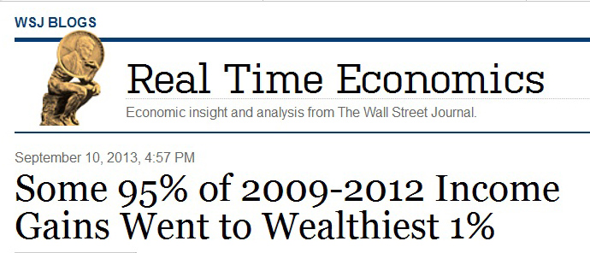
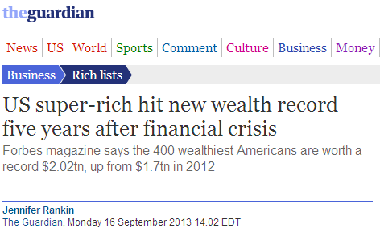
Inequality: Update from 2010
the top 1% saw their incomes climb 31.4% — or, 95% of the total gain — while the bottom 99% saw growth of 0.4%
Last year, the richest 10% received 50.5%, the largest share since such record-keeping began in 1917
Minimum = $1.3 billion (61 billionaires not on the list)
Maximum = $72 billion (Bill Gates)
“Basically, the mega rich are mega richer,” said Forbes Senior Editor Kerry Dolan.
Washington Post, Sept 16, 2013. The rich keep getting richer as the combined net worth of America’s 400 richest rises
Notes:
Leighton, Paul. 2013. Manifestations of Poverty: The Rich Get Richer and the Poor Get Prison. Star Lecture, EMU Honors College. Sept 2013. http://paulsjusticepage.com

Slide 20
Wealth: International Comparison
U.S. (share owned by percentile group) | Percentile group | U.K. (share owned by percentile group)
2.5 | Bottom 50 | 13
26 | 50 to 90 | 42
71.5 | Top 10 | 44
Calculated from Kennickell (2009: 35) and HMRC (2011: Table 13.8). U.K. numbers are based on data from 2005 to 2007.
Notes:
Leighton, Paul. 2013. Manifestations of Poverty: The Rich Get Richer and the Poor Get Prison. Star Lecture, EMU Honors College. Sept 2013. http://paulsjusticepage.com

Slide 21
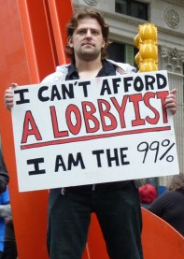
Inequality between real and corporate persons, 2010
International Monetary Fund, World Economic Outlook Database, April 2011. http://www.imf.org
Fortune 500, 2010. http://money.cnn.com/magazines/fortune/fortune500/2010/full_list/.
Notes:
Leighton, Paul. 2013. Manifestations of Poverty: The Rich Get Richer and the Poor Get Prison. Star Lecture, EMU Honors College. Sept 2013. http://paulsjusticepage.com

Slide 22
Country GDP v Corporate Revenue, 2010
Overall Rank | Country Rank | Company Rank | Country/Company | GDP/ Revenue*
1 | 1 |  | United States | $15,065
29 | 29 |  | South Africa | $560
30 |  | 1 | Wal-Mart | $422
32 |  | 2 | Exxon-Mobil | $354
62 |  | 6 | General Electric | $152
66 |  | 9 | Bank of America | $134
70 | 58 |  | Vietnam | $121
71 |  | 13 | J.P. Morgan Chase | $116
73 |  | 14 | Citigroup | $111
86 |  | 23 | Wells Fargo | $93
Fortune 500 from http://money.cnn.com/magazines/fortune/fortune500/2011/full_list/ . International Monetary Fund, World Economic Outlook Database, September 2011. Gross domestic product is expressed in current (2011) U.S. dollars. http://www.imf.org/external/pubs/ft/weo/2011/02/weodata/index.aspx.
* In billions of US dollars
Notes:
Leighton, Paul. 2013. Manifestations of Poverty: The Rich Get Richer and the Poor Get Prison. Star Lecture, EMU Honors College. Sept 2013. http://paulsjusticepage.com

Slide 23
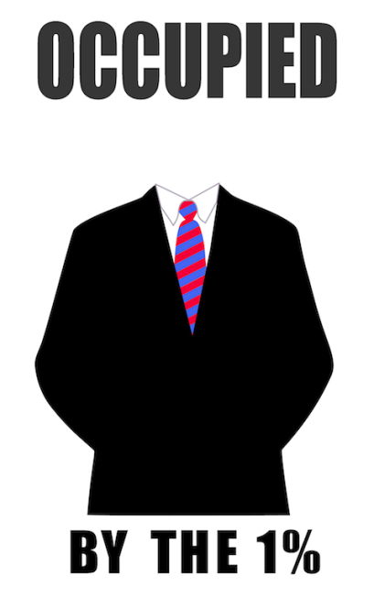
Inequality, Crime and CJ
Inequality
Harms Done by the Rich, the Powerful and Corporations
Law Enforcement & (anti) regulation
Lawyers and Judicial Processing
Sentencing and Prison
Law Making
Inequality worsens crimes of rich and poor. CJ system focuses on poor while rich are processed out of the system at every stage
Notes:
Leighton, Paul. 2013. Manifestations of Poverty: The Rich Get Richer and the Poor Get Prison. Star Lecture, EMU Honors College. Sept 2013. http://paulsjusticepage.com

Slide 24
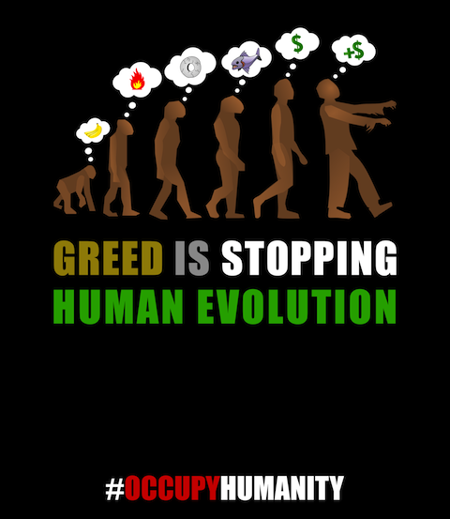
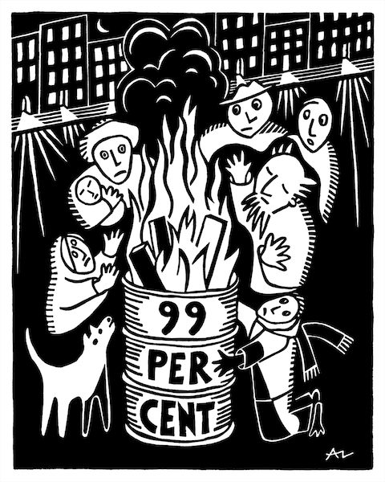
Inequality & Criminology
Inequality worsens both crimes of poverty motivated by need and crimes of wealth motivated by greed
Braithwaite, John. 1992. Poverty Power and White Collar Crime, in Schlegel and Weisburd, White-Collar Crime Reconsidered (Boston: Northeastern University Press).
http://occuprint.org
Notes:
Leighton, Paul. 2013. Manifestations of Poverty: The Rich Get Richer and the Poor Get Prison. Star Lecture, EMU Honors College. Sept 2013. http://paulsjusticepage.com

Slide 25
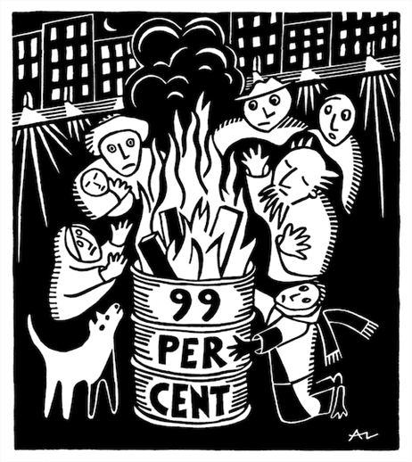
Inequality & crimes of the poor
“Need”: absolute, perceive others to have, what whites have, expectations based on “advertising and dramatization of bourgeois lifestyles” (Braithwaite 1992 p 83)
Fewer legitimate means to success, so more people try illegitimate means
http://occuprint.org
Notes:
Leighton, Paul. 2013. Manifestations of Poverty: The Rich Get Richer and the Poor Get Prison. Star Lecture, EMU Honors College. Sept 2013. http://paulsjusticepage.com

Slide 26
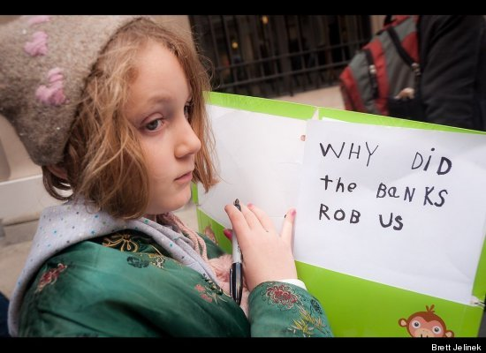
Inequality & crimes of the rich
Having additional money matters to the rich
“increasing concentrations of wealth [enables] the constitution of new forms of illegitimate opportunity” (p 85)
Novel illegitimate strategies that “excel because they cannot be contemplated by those who are not wealthy” (p 88)
“people in positions of power have opportunity to commit crimes that involve the abuse of power, and the more power they have, the more abusive those crimes can be” (p 89)
“undermines respect for the dominion of others” (p 80)
All quotes from Braithwaite 1992
Notes:
Leighton, Paul. 2013. Manifestations of Poverty: The Rich Get Richer and the Poor Get Prison. Star Lecture, EMU Honors College. Sept 2013. http://paulsjusticepage.com

Slide 27
Inequality & Law Making
The 1% are not seen as a special interest and lobby so that the harms they do are
Civil violations (fines) not criminal (prison)
Misdemeanor (minor) not felony
not recognized in law
http://occuprint.org/
“Capitol Hill works like a vending machine. You put coins in the slot, select your law, and the desired legislation slides out” (Ritholtz 2012)
Notes:
Leighton, Paul. 2013. Manifestations of Poverty: The Rich Get Richer and the Poor Get Prison. Star Lecture, EMU Honors College. Sept 2013. http://paulsjusticepage.com

Slide 28
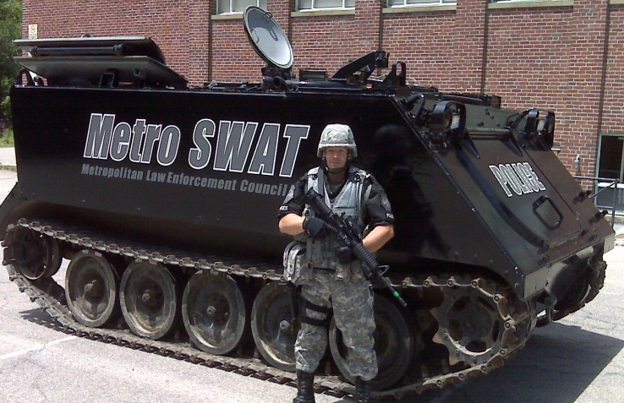
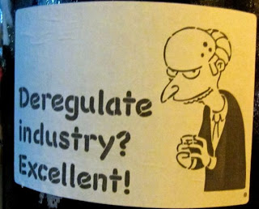
Inequality in Policing/Regulation
Crimes of poor: “get tough” ~ “zero tolerance” ~ “WAR on crime” ~ “law and order”
Policing of the powerful: “deregulation”
Regulators = cops on the beat
We wouldn’t allow the Super Bowl to be played without referees because “we know that players would give in to their worst impulses.” The financial system is the same. Barry Ritholtz, “Where’s the Ref?” Forbes, September 12, 2008.
Notes:
Leighton, Paul. 2013. Manifestations of Poverty: The Rich Get Richer and the Poor Get Prison. Star Lecture, EMU Honors College. Sept 2013. http://paulsjusticepage.com

Slide 29
Inequality in Lawyers & Legal Outcomes
Indigent man on death row: “the lawyer himself was on probation for public intoxication and addicted to crystal methamphetamine… the lawyer would be charged with drug possession, declare bankruptcy and commit suicide” (NYT 2013)
A 2011 study found that death penalty lawyers “often spend little time preparing their cases and put on only the barest defense. They neglect basic steps, such as interviewing defendants, seeking out witnesses, and investigating a defendant's background.”
One upper-class campus drug dealer studied in Dorm Room Dealers described himself as “untouchably wealthy,” ended up with a “possession ticket” because “I got real good lawyers [laughs]. Like real good lawyers… fucking like six lawyers.” (p 159)
Notes:
Leighton, Paul. 2013. Manifestations of Poverty: The Rich Get Richer and the Poor Get Prison. Star Lecture, EMU Honors College. Sept 2013. http://paulsjusticepage.com

Slide 30
Inequality and Criminal Justice
Notes:
Leighton, Paul. 2013. Manifestations of Poverty: The Rich Get Richer and the Poor Get Prison. Star Lecture, EMU Honors College. Sept 2013. http://paulsjusticepage.com

Slide 31
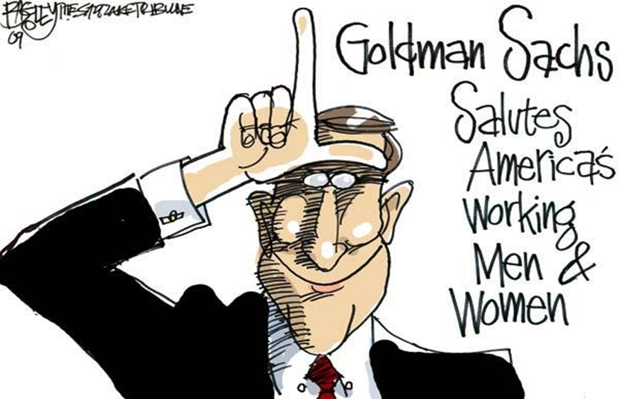
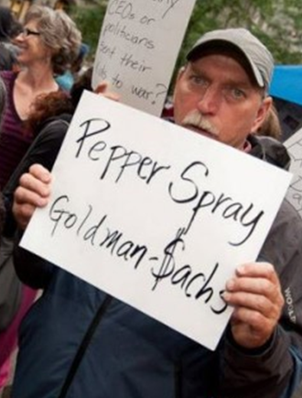
Conclusion I: More inequality than you realize
“to claim to be apolitical or neutral in the face of such injustices would be, in actuality, to uphold the status quo – a very political position to take and on the side of the oppressors” -Sister Helen Prejean, Dead Man Walking
Notes:
Leighton, Paul. 2013. Manifestations of Poverty: The Rich Get Richer and the Poor Get Prison. Star Lecture, EMU Honors College. Sept 2013. http://paulsjusticepage.com

Slide 32
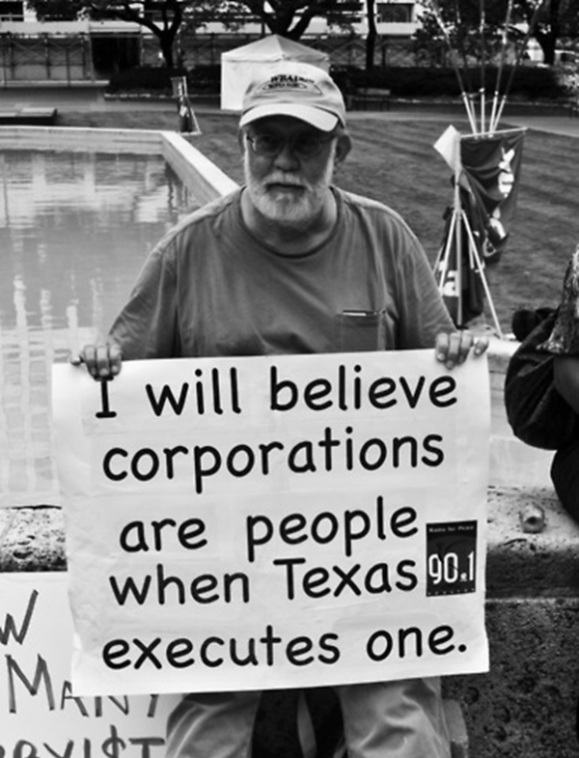
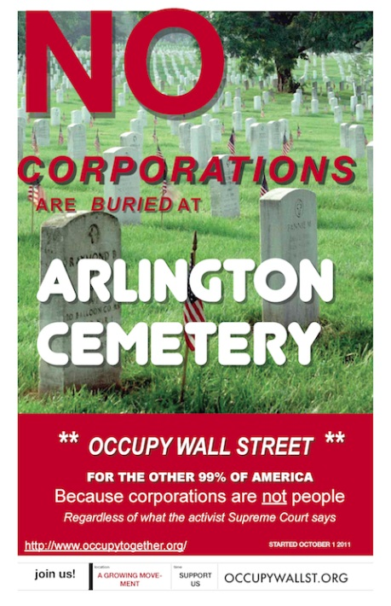
Conclusion II: Corporations have more power than you realize
“people in positions of power have opportunity to commit crimes that involve the abuse of power, and the more power they have, the more abusive those crimes can be” (Braithwaite 1992, p 89)
http://occuprint.org/
Notes:
Leighton, Paul. 2013. Manifestations of Poverty: The Rich Get Richer and the Poor Get Prison. Star Lecture, EMU Honors College. Sept 2013. http://paulsjusticepage.com

Slide 33
Conclusion III: Social Analysis and Criminology ‘Declassed’
But Class is a crucial social variable because
Without attention to white collar and corporate crime, we have the wrong pictures of harms that threaten us and do not pursue policies to advance public safety
CJ can be no more fair than the society for which it provides ‘law and order’ - reflect and recreate injustices in social order
‘Equality under law’ requires assessment of class bias in CJ
Notes:
Leighton, Paul. 2013. Manifestations of Poverty: The Rich Get Richer and the Poor Get Prison. Star Lecture, EMU Honors College. Sept 2013. http://paulsjusticepage.com

Slide 34
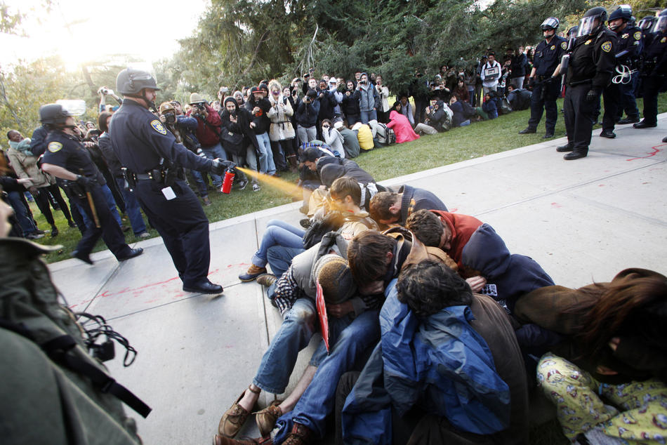
Conclusion IV: Rule of Law increasingly broken
"Everything's fucked up, and nobody goes to jail"
“Power corrupts and unaccountable power corrupts with impunity”
Peaceful protesters get arrested for disorderly conduct, while those who created serious disorder with the world economy keep getting bonuses and go about business as usual. Financial crooks lobby against reform legislation and consumer financial protection.
Taibbi, Matt 2011. Why Isn't Wall Street in Jail? Rolling Stone, Feb 16. http://www.rollingstone.com/politics/news/why-isnt-wall-street-in-jail-20110216
Braithwaite 1992, p 89
Reiman, Jeffrey and Paul Leighton. 2013. The Rich Get Richer and the Poor Get Prison, 10th ed. Boston: Allyn & Bacon
Notes:
Leighton, Paul. 2013. Manifestations of Poverty: The Rich Get Richer and the Poor Get Prison. Star Lecture, EMU Honors College. Sept 2013. http://paulsjusticepage.com

Slide 35
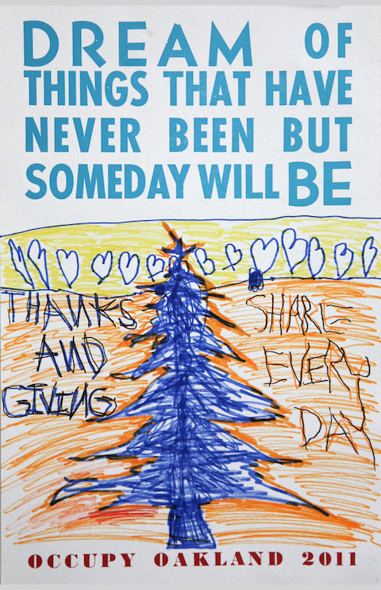
Conclusion V: Need to Raise Basic Questions About Society
In The New Jim Crow, Alexander writes of the poor and working class needing to come together in a multiracial alliance, not to do better within the existing political and economic structure, but (in M. L. King’s words) to “create an era of revolution… We are called upon to raise certain basic questions about the whole society” (in Alexander 2012:259).
http://occuprint.org
Notes:
Leighton, Paul. 2013. Manifestations of Poverty: The Rich Get Richer and the Poor Get Prison. Star Lecture, EMU Honors College. Sept 2013. http://paulsjusticepage.com

Slide 36
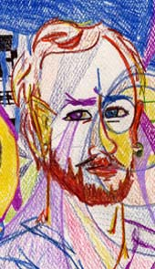
Dr. Paul Leighton is a professor in the Department of Sociology, Anthropology & Criminology at Eastern Michigan University.
More information about him is available on his website,
http://paulsjusticepage.com/paul/pauls-cv.htm
I believe and hope my use of the images in this presentation
is covered by ‘fair use.’ Requests to remove materials should
be sent to the presenter through his address on this page
http://paulsjusticepage.com/paul.htm

