Slide 1
Thinking about a model post-warehouse prison
Punishment, Profit & Rehabilitation:
Dr. Paul Leighton
Eastern Michigan University
2nd Annual Prison Awareness Week Keynote Lecture
University of Toledo Department of Law and Social Thought and Toledoans for Prison Awareness
17 April 2014

Slide 2
The warehouse prison problem

Slide 3
Prison reform: what’s at stake
Big mess, so we need sentencing reform and prison reform
Rational, sustainable public policy to promote public safety
National ideals of freedom and enlightenment
Partnerships with private sector that advance public justice, not corrupt it
If you knew your neighbor was recently released from prison, what kind of prison would you like it to be?
700,000 people released from incarceration each year

Slide 4
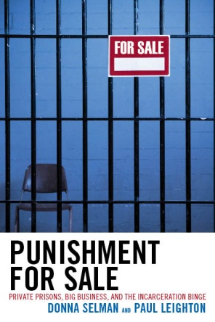
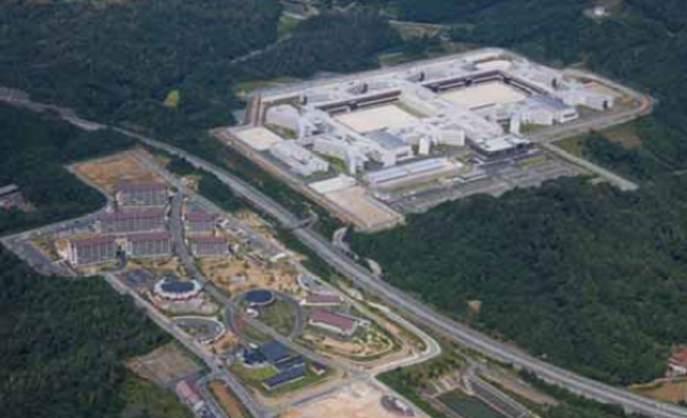
Roadmap
Problems with prisons (well, a few of them)
Shimane Asahi Rehabilitation Center
“model for the next 50 years”
“a prison the public can understand and support”
Conclusion:
Post-warehouse prison
Thanks to the Dept. of Sociology, Anthropology & Criminology at EMU for a development award that facilitated access to Shimane Asahi. Thanks to Alexandra Scarborough for inviting me and making all the arrangements.

Slide 5
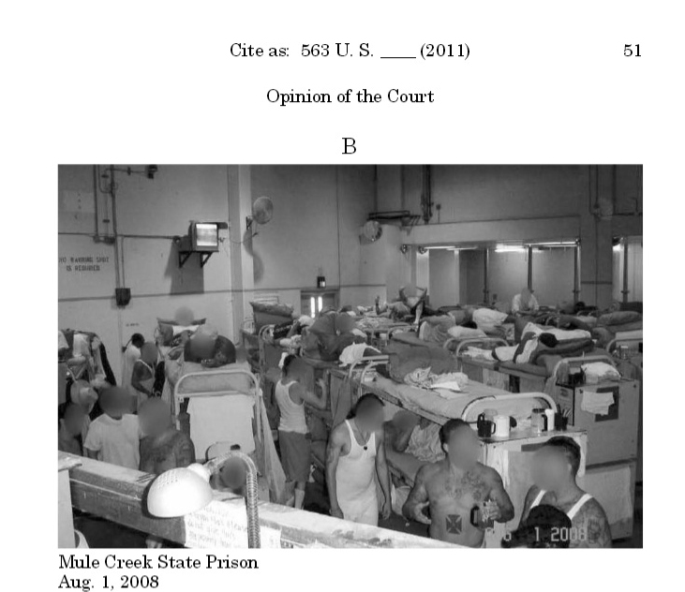
The warehouse prison problem
From Supreme Court decision in Brown v Plata.
California had to release 46,000 inmates to get down to 137.5% of capacity in 2 years.
“Needless suffering and death have been well-documented.” (p 3)

Slide 6
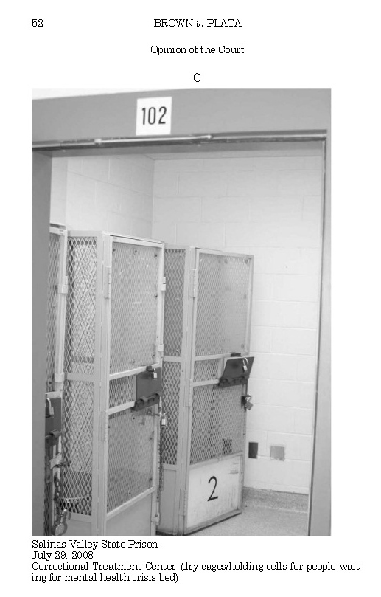
The “warehouse prison” problem
More radical still was a proposed amendment to the state constitution requiring it to spend more on higher education than prisons…

Slide 7
How did we get here? “four-decade mean season in corrections”*
Law & Order
War on Crime
War on Drugs
“Get Tough”
3 Strikes
Mandatory minimums
Truth in Sentencing
Overcrowding
Cut programs
per 100,000 population
*Cullen, quoted in Leighton, Paul. 2014. “A model prison for the next 50 years”: The high-tech, public private Shimane Asahi Rehabilitation Center. Justice Policy Journal, 11(1),

Slide 8
Remember, prison has little to do with the crime rate…

Slide 9
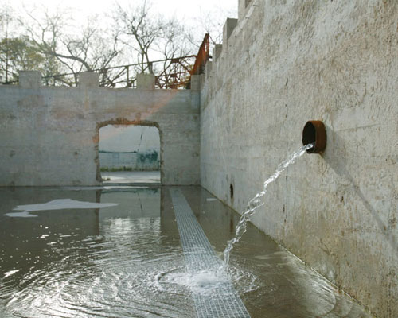
… But can divert money from education and crime prevention
Building prisons instead of funding prevention is like
mopping water off the floor while we let the tub overflow. Mopping harder may make some difference
but does not do anything about the open faucet.
-Elliott Currie
Quoted in Selman and Leighton. 2010. Punishment for Sale. (p 26)
MOP HARDER + CLOSE FAUCET
Photo: Tom Jenkins, http://www.asla.org/awards/2007/07winners/290_mesa.html

Slide 10
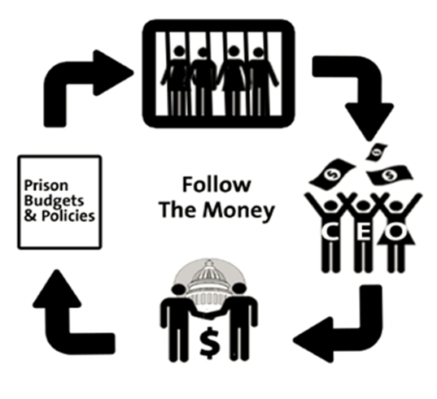
Criminal Justice-Industrial Complex “Bodies destined for profitable punishment”
“Private industries have arisen to profit from grownup fright toward the young and advance their interests by inflaming them further.”
-Mike Males, author of The Scapegoat Generation: America’s War on Adolescents

Slide 11
Military-Industrial Complex
From General/President Eisenhower’s warning of Military-Industrial Complex
New permanent armaments industry of “vast proportions”
“We must guard against the acquisition of unwarranted influence… The potential for the disastrous rise of misplaced power exists and will persist. We must never let the weight of this combination endanger our liberties or democratic processes.”
Complex forms policy in own
interest, minimizes outside
scrutiny and accountability

Slide 12
Criminal Justice-Industrial Complex “Bodies destined for profitable punishment”
Politicians (use fear of crime to gain votes)
Media (sensationalize crime for ratings)
Impoverished rural areas (use prisons as economic development)
Private companies (billions spent on CJ is a lucrative market)
Government officials (expand fiefdoms)
CJ system of ‘vast proportions’

Slide 13
Private Prisons
Nominal privatization: construction, food, medical care, education
Operational privatization: private company operates a facility owned by the government and/or manages inmates in a prison that the company owns.
Both are Real Estate Investment Trusts – pay no federal tax and distribute money to shareholders instead

Slide 14
Private prisons argue they can do this more cheaply and efficiently
PRIVATE PRISONS ARE NOT A SOLUTION

Slide 15
Japan
After WWII, “self-defense force” and little military industry
Low rates of crime and incarceration, so little CJ-industrial complex
Incarceration rate:
US – 707/100,000 (2012)
Japan – 51/100,000 (2013) [51 – not a typo]
(International Centre for Prison Studies, prisonstudies.org)

Slide 16
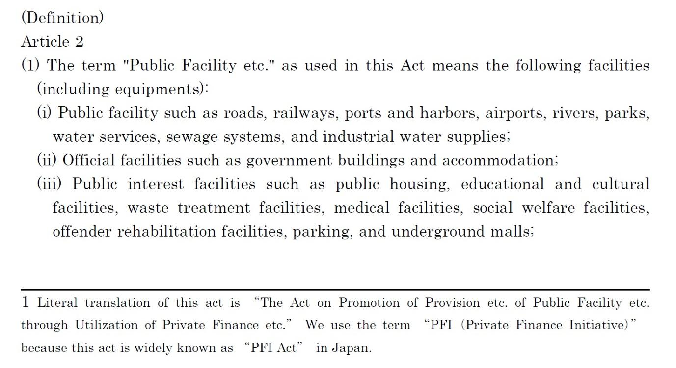
1999 Act on Promotion of Private Finance Initiative (PFI)
Partnerships for “offender rehabilitation facilities” – not prisons
50 localities wanted a PFI prison, built 4
Source for law translation: Cabinet Secretariat, http://www.cas.go.jp/jp/seisaku/hourei/data/pfi.pdf

Slide 17
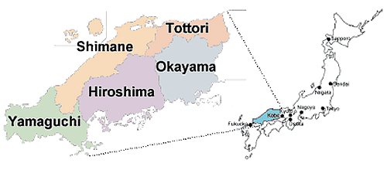
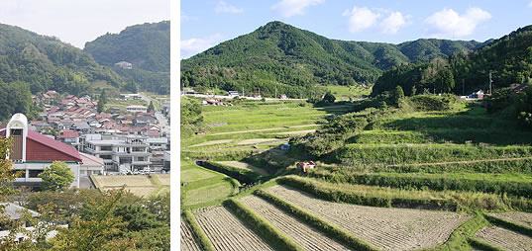
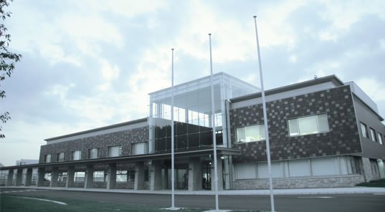
Shimane Asahi Rehabilitation Center
Last of four PFI Prisons to be built
Region rural and elderly; rich farmland, nice scenery
Capacity 2,000
Opened 2008
Images (not map) from Shimane Asahi webpage,
http://www.shimaneasahi-rpc.go.jp/english/area/index.html

Slide 18
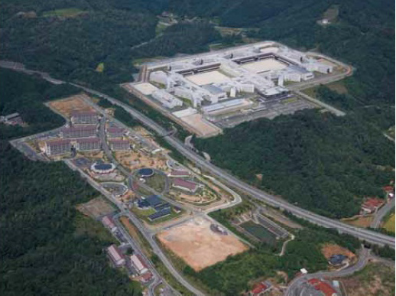
Shimane Asahi Rehabilitation Center
From Akihiko Kimura, The Development of PFI in the Prison Sector in Japan. Presented at the 3rd Annual Meeting for PPP/PFI Promotion Between Japan and Korea
I would like to thank the Warden of Shimane Asahi, Fumiya Tezuka, for allowing me access and giving graciously of his time. Akinobu Sato was a very helpful point of contact and his translation work was invaluable. Atsuko Otsuka also provided high level translation; Our subsequent discussions have added considerable depth to my understanding.

Slide 19
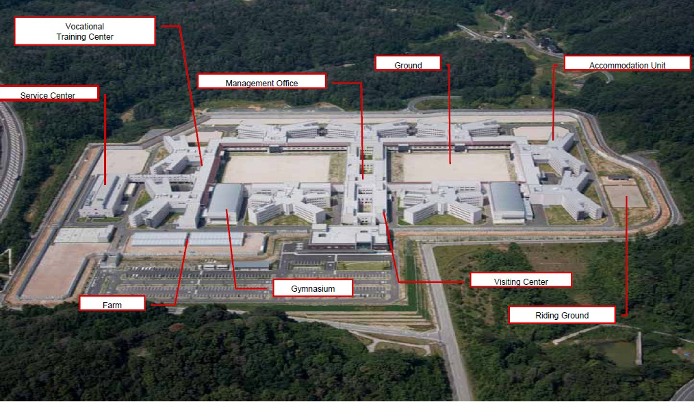
Shimane Asahi Rehabilitation Center
From Akihiko Kimura, The Development of PFI in the Prison Sector in Japan. Presented at the 3rd Annual Meeting for PPP/PFI Promotion Between Japan and Korea

Slide 20
US private prisons v Japanese PFI
Japan
U.S.
Government
Government
Warden,
Directors of Treatment, Support & Planning
+ Contract Compliance
Private
Sector Company
Warden
&
Staff
Private
Sector Companies

Slide 21
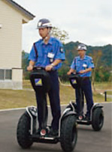
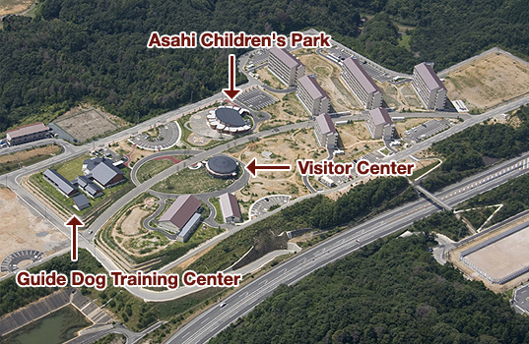
3 “pillars” of Shimane Asahi
Public-private partnership
Technology and innovation
Education, vocational training and rehabilitative programs
Special programs, training and therapeutic gardens for emotionally disturbed inmates
Partnership with the local community
“Co-building” – Center for Regional Engagement
…”aims to create prisons that the public can understand and support”
Shimane Asahi website, http://www.shimaneasahi-rpc.go.jp/english/first/index.html

Slide 22
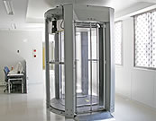
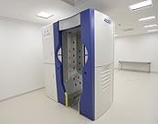
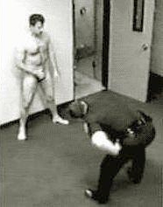
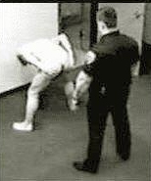
Technology & innovation I
Scanning equipment for drugs and contraband…
… means no strip searches
Better environment for inmates, guards and inmate-guard relationships

Slide 23
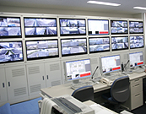
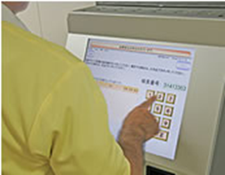
Technology & innovation II
“Location information system” – RFID tags that show the inmates’ location in real time
No lockdowns for daily counts
Warning when inmates out of place
+660 cameras
Watch inmates and remotely open doors – “moving around unescorted”
Kiosk (commissary, appointments)
From Shimane Asahi website, http://www.shimaneasahi-rpc.go.jp/english/tokucyo/index.html

Slide 24
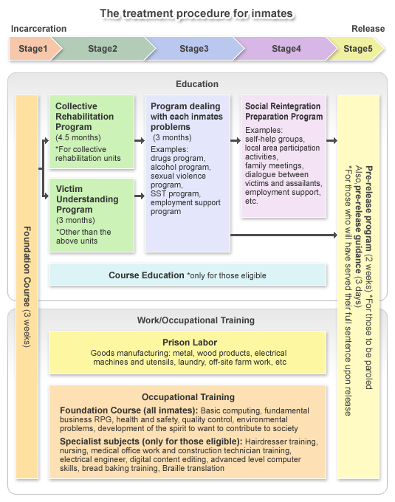
Programs I
“programs that have proved to reduce the recidivism rate in Europe and the United States”
+ Horse (“Equine Assisted”) Therapy and Horticulture
From Shimane Asahi website, http://www.shimaneasahi-rpc.go.jp/english/torikumi/index.html

Slide 25
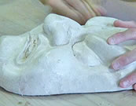
Programs II
Mentally and emotionally disturbed inmates
Making masks and beaded costumes for local festival
Therapeutic gardens
Social skills training
From Shimane Asahi website,
http://www.shimaneasahi-rpc.go.jp/english/torikumi/index.html

Slide 26
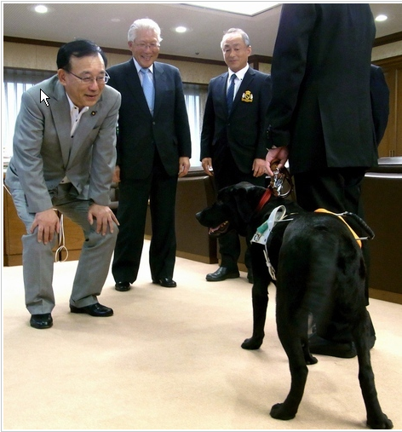
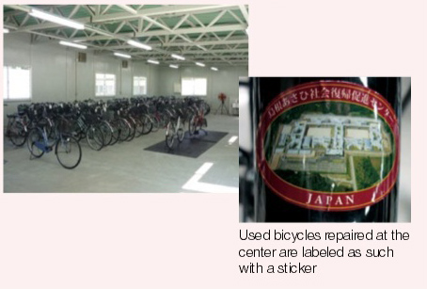
Programs III (Giving Back)
Translate books into Braille
Train Seeing Eye Dogs
First Japanese prison-based guide dog program
Repair bicycles for 3rd World medical workers and Great East Japan Earthquake victims
Minister of Justice with first certified guide dog trained in a prison (Asahi.com, 20 June 2013)
Obayashi Corporate Report 2012: Financial, Social and Environmental Performance

Slide 27
Regional Engagement
From Akihiko Kimura, The Development of PFI in the Prison Sector in Japan. Presented at the 3rd Annual Meeting for PPP/PFI Promotion Between Japan and Korea

Slide 28
Conclusion: Toward a US post-warehouse model prison
Tough on Crime
‘Smart’ on Crime
It is time to think about the quality of prison as well as the quantity of imprisonment
quoted in Leighton, Paul. 2014. “A model prison for the next 50 years”: The high-tech, public private Shimane Asahi Rehabilitation Center. Justice Policy Journal, 11(1), http://www.cjcj.org/uploads/cjcj/documents/leighton_model_prisons_final_formatted.pdf.

Slide 29
The post-warehouse prison
Sentencing reform
End mass incarceration, hyperincarceration and A Plague of Prisons (Drucker)
“Let the crime fit the harm and the punishment fit the crime” – more criminalization and policing of harms of the powerful [Reiman and Leighton. 2013. The Rich Get Richer & the Poor Get Prison, 10th ed, p 211]
http://www.peoplesmovementassembly.org

Slide 30
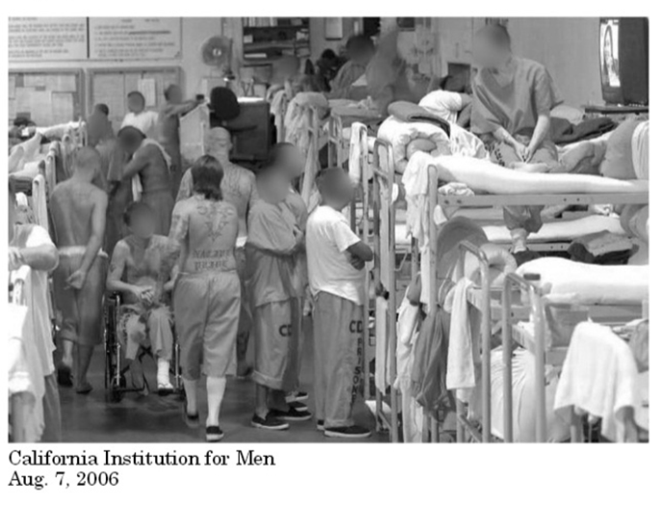
The post-warehouse prison
Fewer warehouse prisons
Reform/improve/transform existing warehouse prisons
and
Create experimental space for next-generation rehabilitation center
If you knew your neighbor was recently released from prison, what kind of prison would you like it to be?

Slide 31
The post-warehouse prison
Reaffirm rehabilitation…
“the rehabilitative ideal draws its power from its nobility and its rationality — from the promise that compassionate science, rather than vengeful punishment, is the road to reducing crime.
Rehabilitation allows us to be a better and safer people”
-Francis Cullen
quoted in Leighton, Paul. 2014. “A model prison for the next 50 years”: The high-tech, public private Shimane Asahi Rehabilitation Center. Justice Policy Journal, 11(1), http://www.cjcj.org/uploads/cjcj/documents/leighton_model_prisons_final_formatted.pdf.

Slide 32
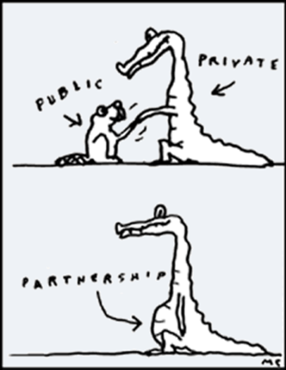
The post-warehouse prison
… but no “industrial complexes”
Public-private partnerships feasible political compromise.
However:
Ensure govt. control of punishment
Local groups and resources
Non-profits and NGOs

Slide 33
The post-warehouse prison
What are the barriers?
How do we organize for change?
If sensible prison policy requires that we treat the non-criminal poor better, is that a barrier?
http://occuprint.org

Slide 34
Dr. Paul Leighton is a professor in the Department of Sociology, Anthropology & Criminology at Eastern Michigan University.
More information about him is available on his website,
http://paulsjusticepage.com/paul/pauls-cv.htm
I believe and hope my use of the images in this presentation is covered by ‘fail use.’ Requests to remove materials should be sent to the presenter through his address on this page
http://paulsjusticepage.com/paul.htm

