Slide 1
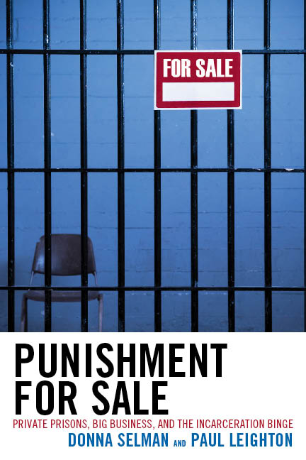
The Problems with Private Prisons
Dr. Paul Leighton
Eastern Michigan University
Presented at A Statewide Forum on Privatization of Prisons, Mass Incarceration and Prison Reform in Michigan
Eastern Michigan University – April 13, 2013

Slide 2
Definition
Nominal privatization: contracting for construction, food, medical care, education
Operational privatization: private company operates a facility owned by the government and/or manages inmates in a prison that the company owns.
Both are real Estate Investment Trusts – pay no federal tax and distribute money to wealthy shareholders instead

Slide 3
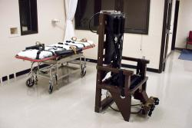
Legitimacy
No private police (power to arrest, use deadly force)
No private courts
Why are private prisons morally acceptable then?
Would a privatized death row be acceptable?
Contract out executions if it saved 10%?
Have a contractor run whole state prison system?
If NO, then why are we going
down this road?

Slide 4
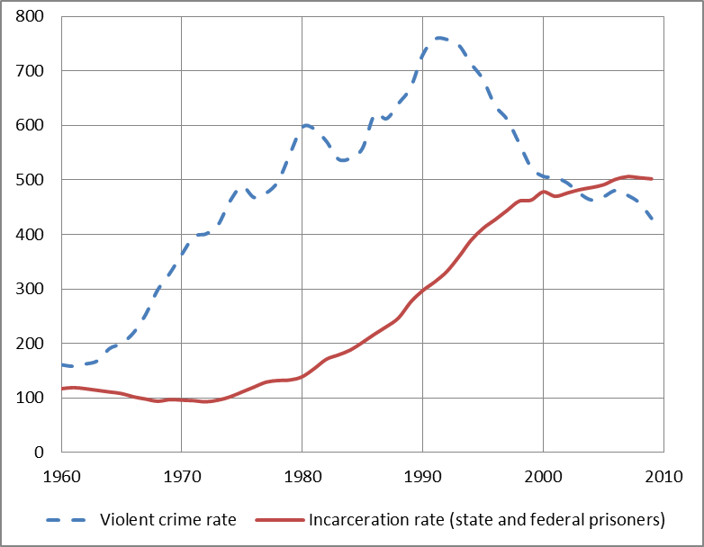
War on Crime/Drugs Incarceration Binge
Overcrowding, need more prisons while promising smaller govt/lower taxes
Private prisons raised money from “public” [wealthy] to continue incarceration binge of poor and profit
Private prisons were born from unjust policy; they depend on its continuation for growth and profit – need “raw materials” and “Bodies destined for profitable punishment”

Slide 5
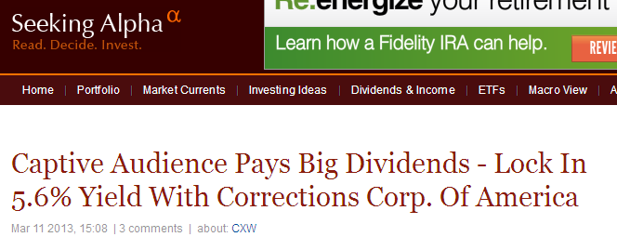
Add to Prison-Industrial Complex
From General/President Eisenhower’s warning of Military-Industrial Complex
New permanent armaments industry of “vast proportions”
“We must guard against the acquisition of unwarranted influence… The potential for the disastrous rise of misplaced power exists and will persist. We must never let the weight of this combination endanger our liberties or democratic processes.
Complex forms policy in own interest, minimizes outside scrutiny and accountability
“Iron Triangle” of legislators, bureaucrats and corp interests

Slide 6
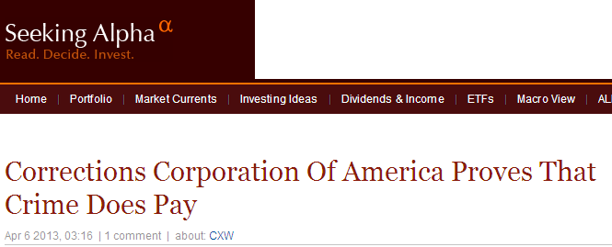
“Endanger democratic processes”
GEO Group, 2010 Annual Report “Risk Factors”:
the demand for our services could be adversely affected by the relaxation of criminal or immigration enforcement efforts, sentencing or deportation practices, and the decriminalization of certain activities. For example, any changes with respect to the decriminalization of drugs could affect the number of persons arrested, convicted, sentenced and incarcerated, thereby potentially reducing demand for correctional facilities to house them.

Slide 7
Follow the $
Overhead costs
Executive pay, executive pay consultants
Customer acquisition (lobbying, political donations)
Lawyers for Securities and Exchange Commission filings
Investor relations, shareholder lawsuits
Consultants for mergers, acquisitions, reorganization
Auditing (international operations)
How can they supposedly do it cheaper
and make a profit?

Slide 8
Promote Inequality: Top Wage in Public DOC v Private Prisons, 2007
CEO salary excludes stocks and stock options. Inmates under supervision excludes probation and parole.
From Selman and Leighton, Punishment for Sale (Rowman and Littlefield, 2010)
Notes:
Highlight inmates comparison GEO = Michigan or New York (if we don’t count parole or probation); CCA = Florida
Fiscal Responsibility comparison GEO smaller than Georgia; CCA = Michigan

Slide 9
Follow the $
Able to make profit and provide the same service with higher overhead costs by screwing the people who work in the prisons
Median earnings in 2006 for correctional officers and jailers was
$35,760 for government employees
$25,050 for private prisons
Lower wages = More employee turnover
Source: Bureau of Labor Statistics 2008–2009, quoted in Barak, Leighton & Flavin (2010) Class, Race, Gender & Crime

Slide 10
Save 5% but weaken Michigan economy
Public
Private
$
Michigan salaries
CEO pay, Wall St lawyers & consultants, lobbying, campaign donations, supplies, food, etc
$ out of state for supplies, food

Slide 11
Next steps?
Data about cost savings unclear, need to privatize more to get better data….
Comparison based on daily rate for 90% occupancy, but if we are only using 86% occupancy, then actual cost per inmate is higher – NEED TO USE ACTUAL AMOUNTS PAID & NUMBER OF INMATES HOUSED
Cost to state for privatization – prepare proposals, evaluate bids, negotiate contract, monitor. IF WE DID NOT HAVE PRIVATIZATION, THEN STATE WOULD NOT INCUR THESE COSTS

Slide 12
Contract Problems
Weak and flawed systems of monitoring
Companies deal with more contracts and better understand the profit-making potential of certain contractual language
Maintenance
Few penalties for violating contract, insufficient for deterrence
“Take or Pay”: Pay for 90 or 95% occupancy regardless of actual number of inmates
guaranteed revenue for corporation, questionable benefits for govt that pays for “ghost” inmates

Slide 13
Conclusion
Questionable legitimacy
Poor transparency (corp secrets)
Poor contracts
Little cost savings
Add to inequality
Weaken state economy
Add to prison-industrial
complex/vested interests in more
unjust mass incarceration
Corporate interests corrupt
democratic policy- making about
justice and public safety

Slide 14
Dr. Paul Leighton is a professor in the Department of Sociology, Anthropology & Criminology at Eastern Michigan University.
More information about him is available on his website,
http://paulsjusticepage.com/paul/pauls-cv.htm
I believe and hope my use of the images in this
Presentation is covered by ‘fair use.’ Requests to
remove materials should be sent to the presenter
through his address on this page
http://paulsjusticepage.com/paul.htm

Slide 15
Eastern Michigan University, April 13, 2013

